Slide 1
Get Groovy
I dare you to.
Code available at
https://github.com/jkelly467/cvcc14_groovy
Notes:
I don’t have anything against Java, I actually like it well enough. I’ve gotten to know it pretty well, because I had to. If you work with Java, you write a lot of Java, because you have to.
Java, the language, has some warts for sure. But, as it turns out, one of the best things about Java is the virtual machine it runs on. The JVM is pretty much universal, it’s fast, and it runs byte code, not Java code. Thanks to that, other languages can be written to run on the JVM, and that has given us some very performant languages that can fix a lot of Java’s issues. One of those languages is Groovy, and I want to show you all a few of the things I enjoy about it.

Slide 2
History
James Strachan dreamed up Groovy in 2003
Version 1.0 released in 2007
Won the JAX 2007 innovation award

Slide 3
Main Concepts
Agile programming for the JVM
Designed for ease of use and quick iteration
Syntax and features brought in from Ruby and Python (among others)

Slide 4

Examples

Slide 5
Dynamic Typing
Obviously, Java requires types to be defined explicitly at the compilation step
In Groovy, an object’s type is discovered dynamically at runtime

Slide 6
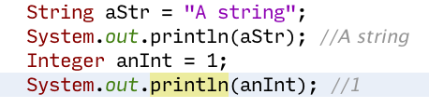
Java
Notes:
Pretty straightforward

Slide 7
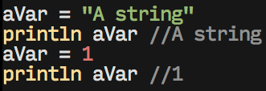
Groovy
Notes:
Not much different, but there’s a couple important things to point out
System.out is gone, aVar was never given a type, aVar was used to store two different data types, no semicolons

Slide 8
More Dynamic Typing
We don’t need to explicitly declare types when defining class variables or function parameters either
This can give us polymorphism without inheritance, and save us a bunch of code

Slide 9
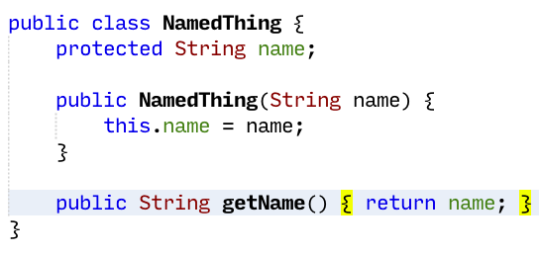
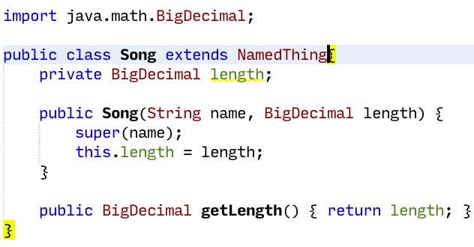
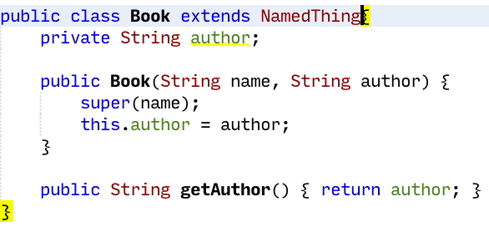
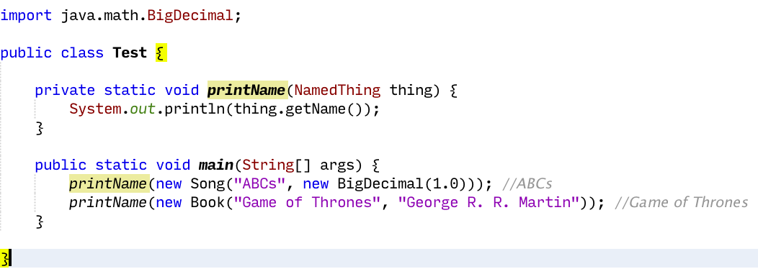
Java
Notes:
Explanation…
That looks ugly, but it serves a purpose: Java requires a lot of code to do this contrived example.

Slide 10
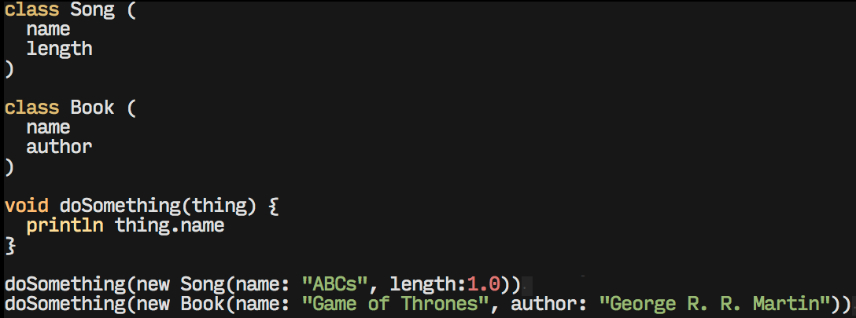
Groovy
Notes:
We didn’t have to declare types on any of the variables, and neither of the classes extended anything
Our method didn’t care what we gave it, as long as it had a “name” field
Note new way of creating objects

Slide 11
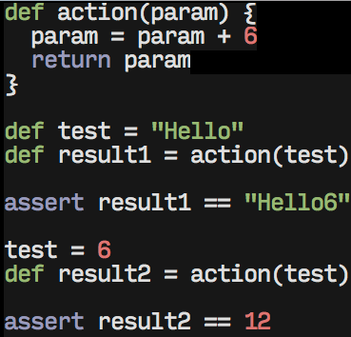
Dynamic Typing - def
Notes:
def essentially means we don’t care about the type

Slide 12
Closures
A code block, similar to anonymous inner classes in Java
Code that is defined and run later
Java 8 has a lot of this
Notes:
This was a little more special before it was added to Java 8, but Java 8 is still out of reach for most developers.

Slide 13
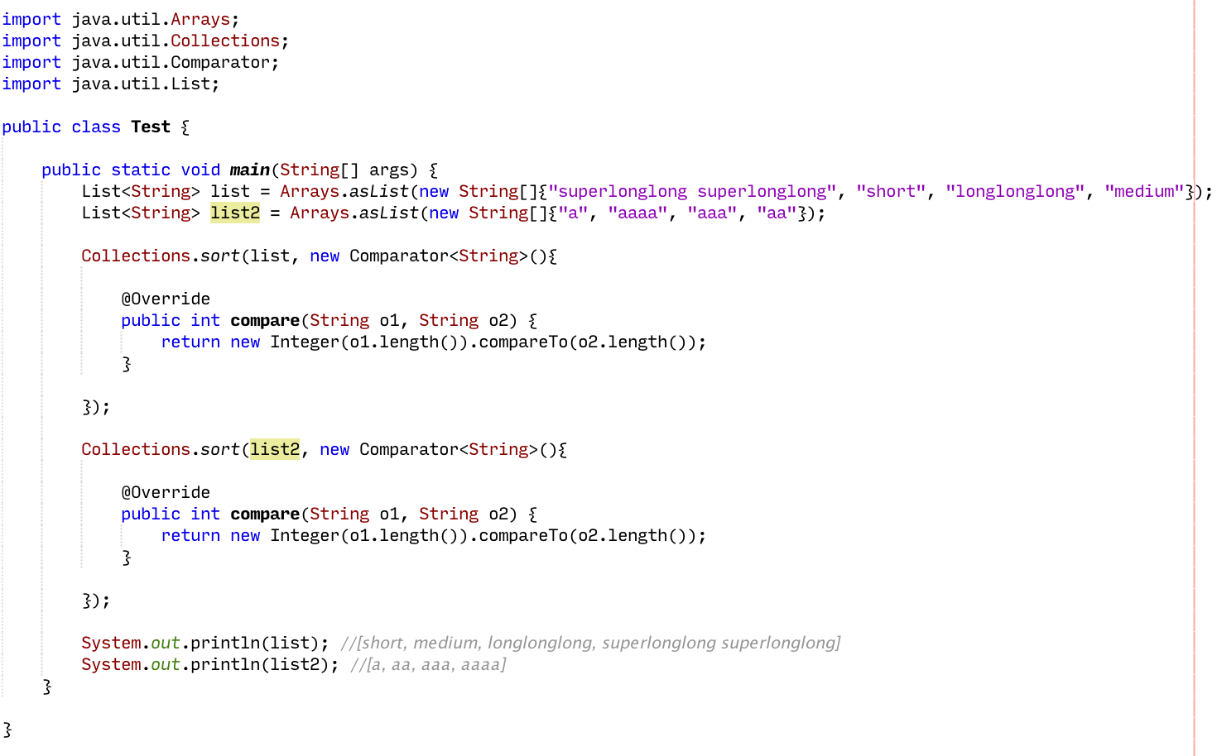
Java
Notes:
We just want to sort two lists of strings by the length of the string

Slide 14
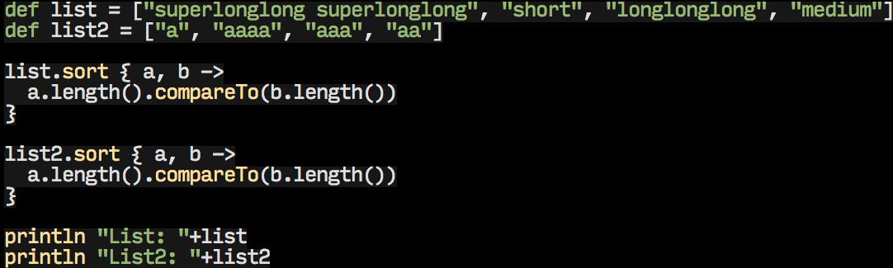
Groovy
Notes:
Taste of groovy’s way of declaring lists
Lists have a sort method which takes a Closure
Parameters are listed before the arrow. Sort takes two members of the list

Slide 15
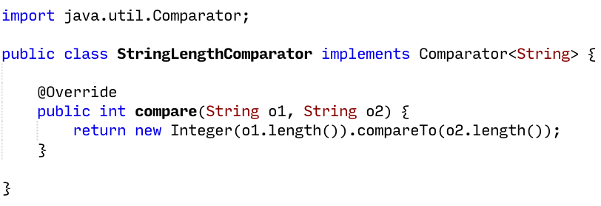
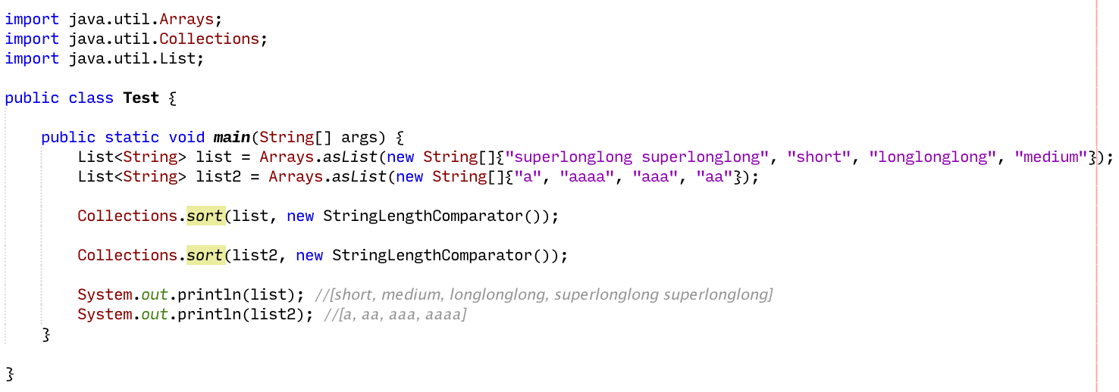
Java
Notes:
Obviously, we can reduce code duplication by defining the comparator as it’s own class and just using that.

Slide 16
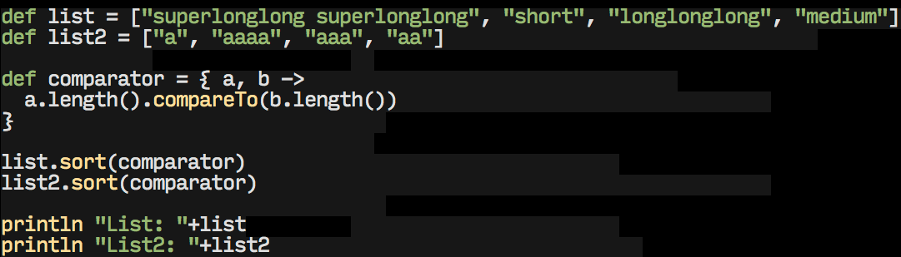
Groovy
Notes:
I wouldn’t have shown you that if Groovy couldn’t do that too.
Except the comparator is defined right along side the rest of the code.
And it has access to variables outside of it’s definition, as long as they’re within the scope in which the closure is run.
So here’s something Java can’t really do.

Slide 17
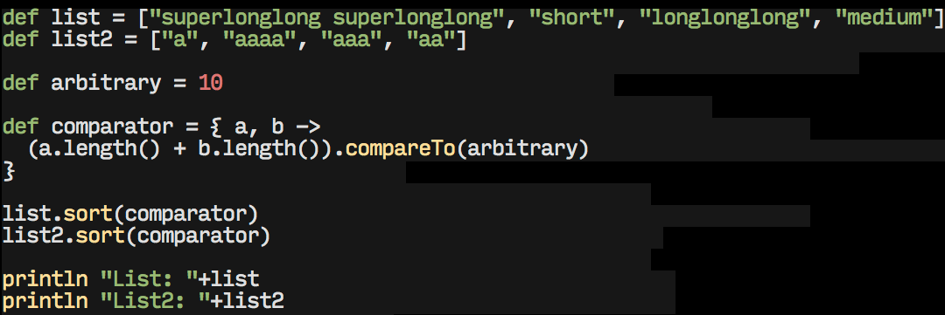
Groovy?
Notes:
So we’re going to add up the lengths of both strings and compare it to 10.
I have no idea what that even means, but you can do it in Groovy.

Slide 18
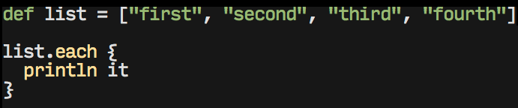
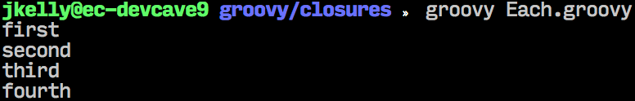
Functional - each
Notes:
Iterating over a list
“it” param, default name for the parameter of any single parameter closure
Notice I can run this easily from the terminal without any compilation step - Groovy is runnable as a scripting language

Slide 19
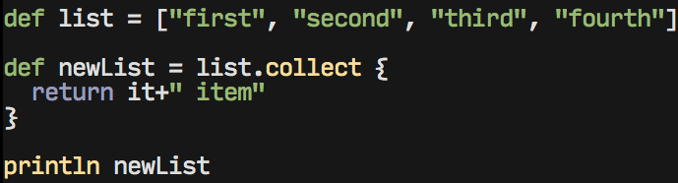
Functional - collect
Notes:
Transform a list into a different list by apply a function to each element
The “map” function. There is also a “reduce” function on collections called inject.

Slide 20
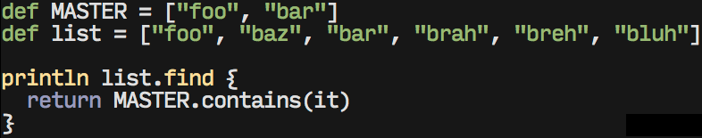
Functional - find
Notes:
Find the first element for which the closure returns true
Note another use of externally defined variables

Slide 21
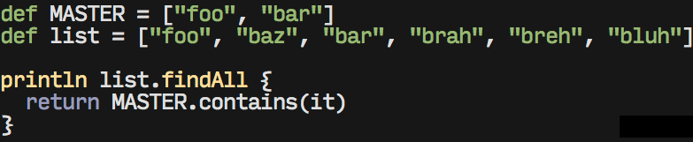
Functional - findAll
Notes:
Find every element in a list for which the closure returns true

Slide 22
Sweet Sweet Groovy
Some nice stuff to make your life easier
Notes:
They didn’t have to throw this stuff in, but they did. Because they love you.

Slide 23
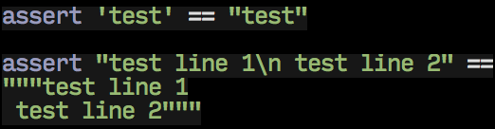
Strings
Java has one way to declare Strings. That’s boring
Groovy has 3!
Notes:
Single quotes and double quotes work
Additionally, there’s the 3 double quote text block syntax, which preserves whitespace and new lines

Slide 24
Groovy Strings
The, erm, GString. Allows templating style when creating strings
Anything enclosed by ${} in a double quoted string will be evaluated as a Groovy expression
This includes Closures

Slide 25
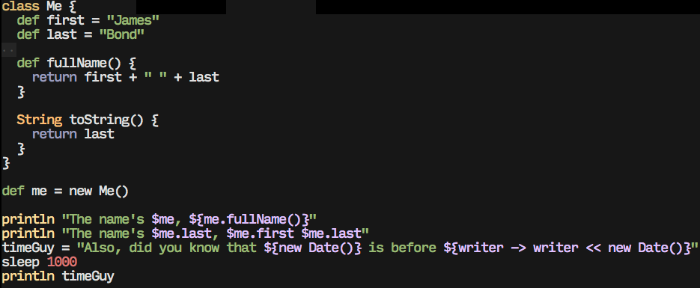
Notes:
There’s a couple different ways to generate the same result. $me invokes the toString method. Properties can be access via dot notation. Methods can be invoked with the curly bracket syntax
In the date example you’ll notice the first date is evaluated at declaration, but the closure is run when the string is printed, 1 second later. So you can declare a string that depends on a variable that doesn’t exist yet, as long as it exists when you evaluate the string.

Slide 26
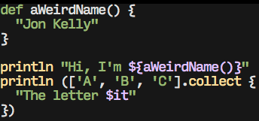
Implicit Return
The last statement in a method or closure will be returned

Slide 27
Groovy Truth
Groovy borrows some of the concepts of “Truthy” and “Falsey” from languages like JavaScript
Empty lists and maps, iterators with no more elements, empty strings and nulls are coerced to false
Regex Matchers with at least one match, non-zero numbers and non-null objects are coerced to true

Slide 28
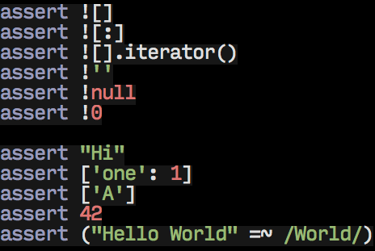

Slide 29
Default method params
Groovy can handle default parameters when declaring a method
This basically does traditional Java “telescoping” behind the scenes

Slide 30
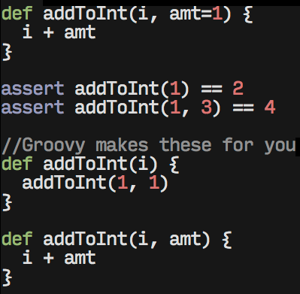

Slide 31
Multiple Assignment
Multiple variables can be assigned at once.
Left side: variable names in parentheses
Right side: array of values

Slide 32
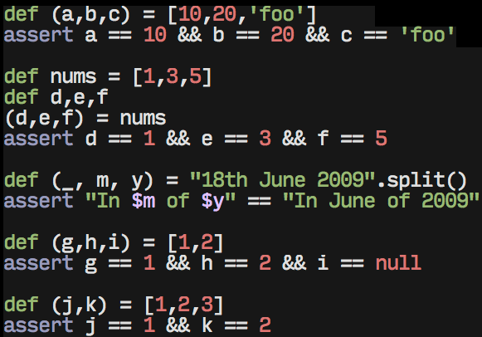
Notes:
Notice _ to say you don’t care about a certain value
If the left side has too many variables, the extras are null
If the right side has too many variables, the extras are ignored

Slide 33
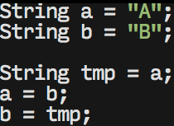
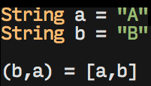
Java
Groovy
Notes:
Recognize this?
Easy swap, finally.

Slide 34
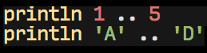
Ranges
Range syntax to create lists of sequenced data
Notes:
Ranges can be used with any class that implements Comparable, and has next and previous methods to return the next/previous item in the range.
Therefore I give you my stupidest example yet.

Slide 35
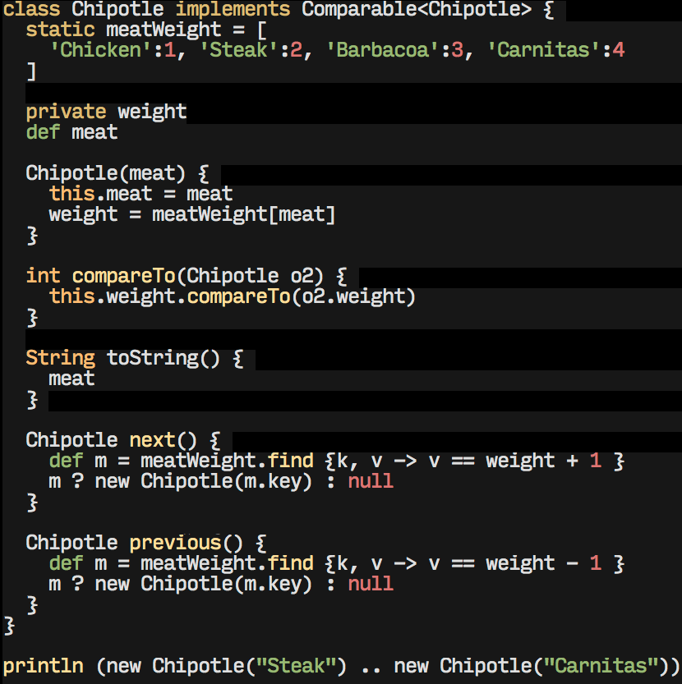
Notes:
So here we can create a range of Chipotle meats. Thank goodness.

Slide 36
Operators
<=> “Spaceship” for comparisons
“in” as shorthand for collection.contains() (1 in [1,2] == true)
?. for safe navigation - No more null pointers! (a?.b?.c returns null even if a or b are null)
?: “Elvis” for shortened ternary (a ? a : “null” == a ?: “null”)
Notes:
Groovy has some new operators for you
Spaceship returns -1 if left is smaller, 0 if they’re equal, 1 if left is greater than right

Slide 37
Operators - Spread (*.)
Invoke an action on each element of an aggregate object
Can be a method call or property access

Slide 38
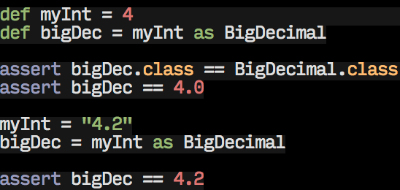
Operators - as
Casts one type to another
Can be smarter than straight Java type casting
Notes:
It knows how to convert a string to a BigDecimal
Most of the time, converting between basic types (String, Integer, Long, BigDecimal, BigInteger, etc…) works without a hitch

Slide 39
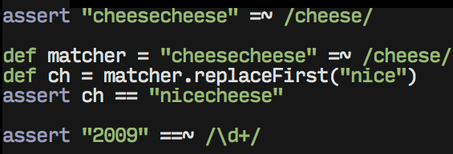
Regex operators
=~ : Find with a regex (creates a Matcher)
==~ : Get a match with a regex (returns true or false)
Notes:
Few things: Notice easier pattern creation syntax, forgoes string escaping that’s currently necessary in Java’s Pattern constructor
The matcher that’s created by =~ evaluates to true if it has at least 1 match

Slide 40
Even Groovier
Advanced Cool Guy Stuff

Slide 41
Metaprogramming
Groovy gives you access to the internals of a class
This allows you to access, add, and modify properties directly
Thanks to closures, we can also add methods to classes dynamically

Slide 42
The meta class
Accessed by .metaClass, on either a Class or instance
Can inspect via .properties and .methods
Also has .hasProperty and .respondsTo methods to test whether an object has a certain property or method
Notes:
Let’s look at an example

Slide 43
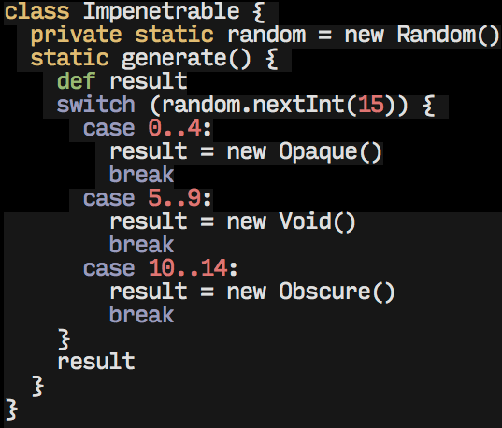
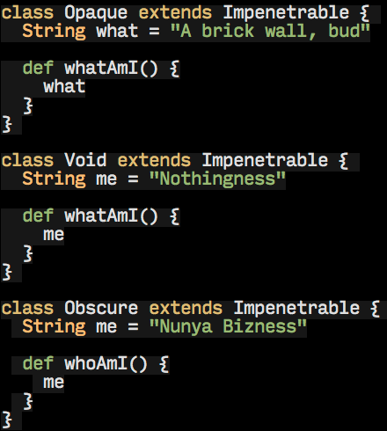
Notes:
Three implementations of Impenetrable. We’re going to forget how these are implemented soon.
Impenetrable will give us a random implementer when we ask
Notice some of the advantages of the sweet new case statement

Slide 44
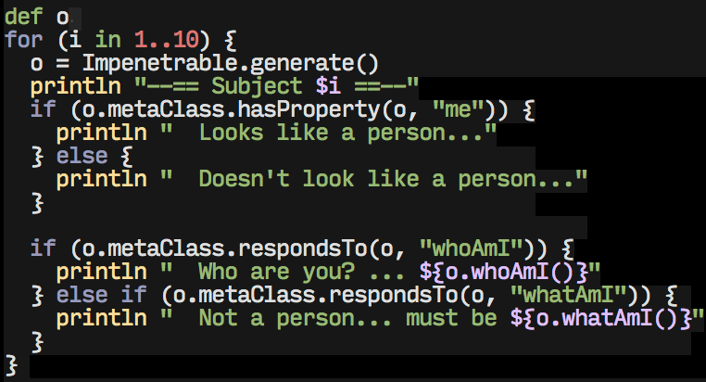
Inspecting random Impenetrables
Notes:
We’ll get 9 Impenetrables. Based on what we can gather from meta class methods, we’ll try to determine who or what we’re dealing with
Notice hasProperty and respondsTo calls

Slide 45
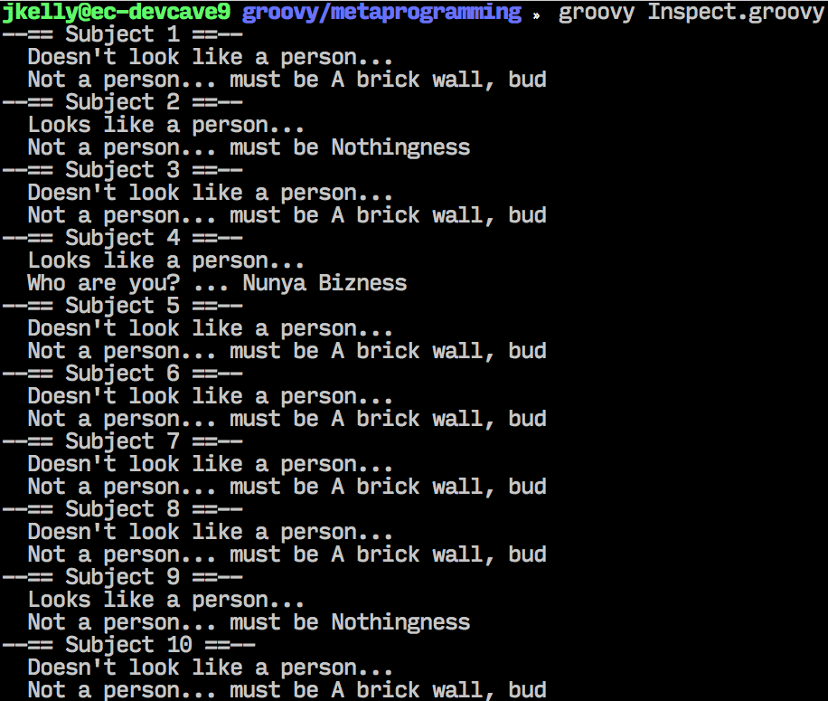
Result
Notes:
So we were able to tell between a brick wall, Nunya Bizness, and some sort of intelligent void without needing type casting or instanceof checks or anything.

Slide 46
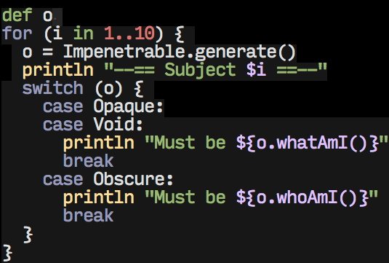
Another method - Case
Notes:
If we knew the implementations of each of these classes, we could simplify this using the new and improved case statement
We can switch on type

Slide 47
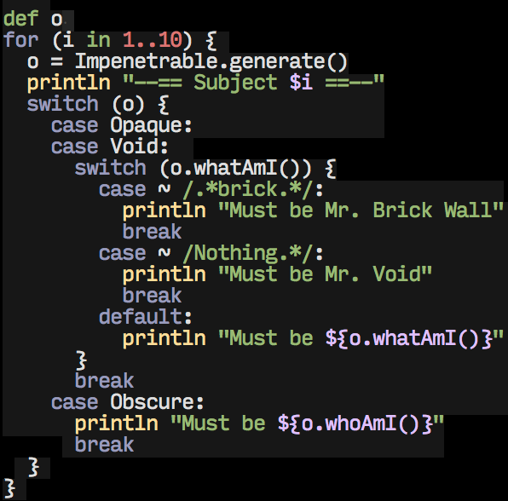
More case stuff
Notes:
We can switch on a regex. Notice “tilde-regex” syntax for creating a pattern.
Groovy cases are pretty cool.

Slide 48
Method addition
You can dynamically add a method to a class, and it’s not even hard

Slide 49
But first - delegates
Each closure has a few variables
“this” - The instance of the class the closure was defined in
“owner” - Same as this unless the closure was defined inside another closure
“delegate” - Same as owner by default, but it can be changed programmatically
Notes:
So when we say “delegate” inside a closure, it essentially means the object that we’ve chosen will be “this” when the closure is run. If you’re adding a method to a class, delegate is going to be the instance you invoke the method against.

Slide 50
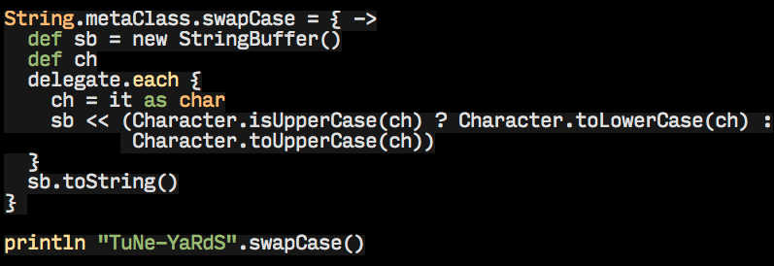
Not Even Hard
Notes:
Here we add a method to swap the case of every character in a String, so we can fix my mangled spelling of that one experimental indie-folk band
Notice delegate here refers to the String that swapCase was invoked on

Slide 51
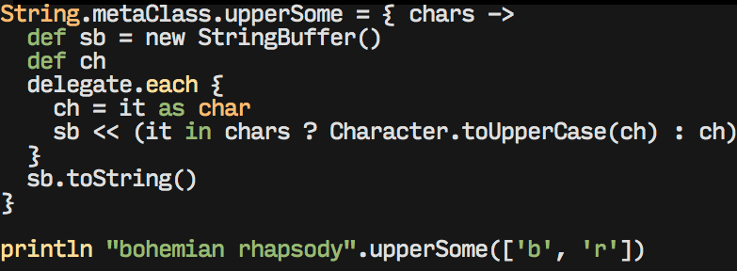
Notes:
Added methods can also take parameters
Remember I said you can change the delegate of a closure? Let’s take a look at an example of that

Slide 52
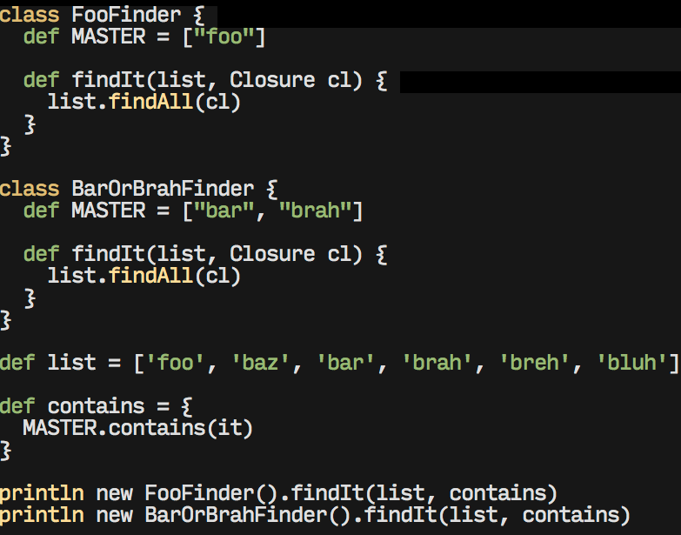
Notes:
Defining our closure we want to use outside of either classes that are using it.
But it didn’t quite work… looks like it doesn’t know about the MASTER variable

Slide 53
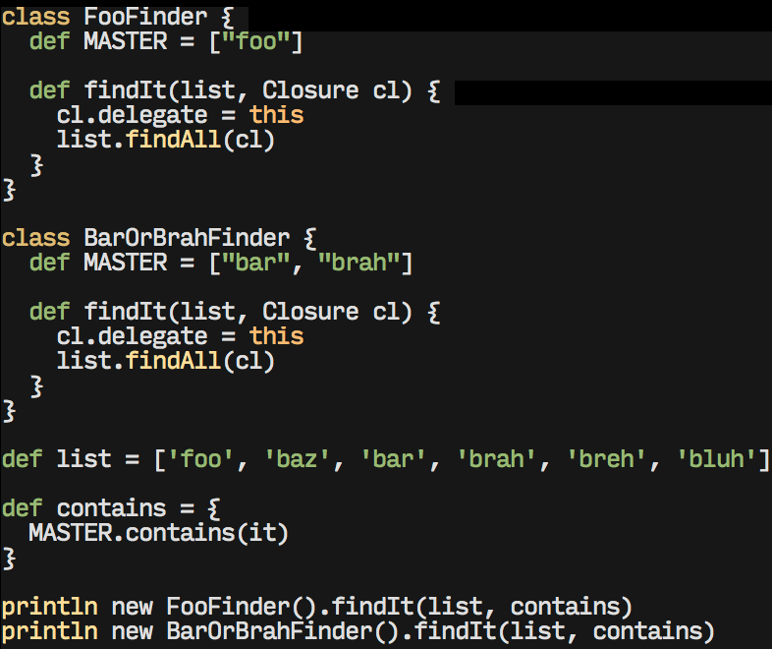
Notes:
Changing the delegate essentially changes the scope of the closure, giving it access to the MASTER list
This gives us what we would expect

Slide 54
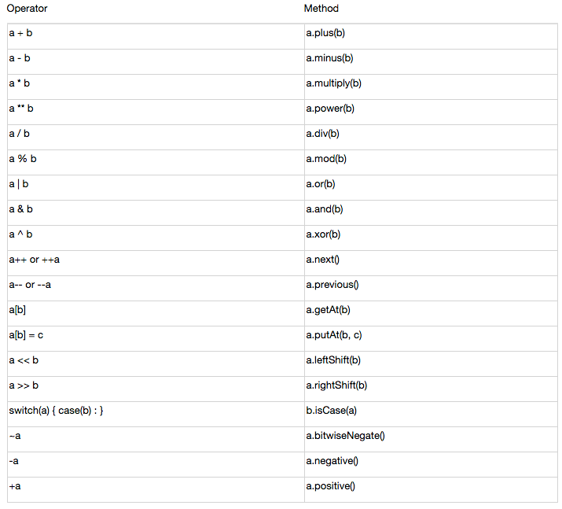
Operators as methods
Notes:
Groovy turns certain operators into method calls behind the scenes. Normally that wouldn’t be a big deal, but since we know about method addition, we know that gives us operator overloading.

Slide 55
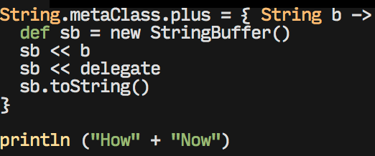
Overloading
How to mess with your friend’s Groovy project
Notes:
You also see how the left shift bitwise operator was overloaded for StringBuffer. It’s essentially the same as append.
The same is true for lists and maps.

Slide 56
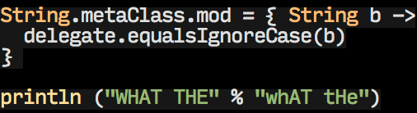
Groovy interprets this as “WHAT THE”.mod(“whAT tHe”), so…
Notes:
So you don’t normally see String % String, but we can turn it into an analog for case-insensitive equals.
Or we could do pretty much anything else you can think of with it

Slide 57
Categories
If you don’t feel comfortable extending or changing the internals of a class permanently, you have categories
Categories allow you to extend classes only within the scope of a “use” block
Borrowed from Objective-C

Slide 58
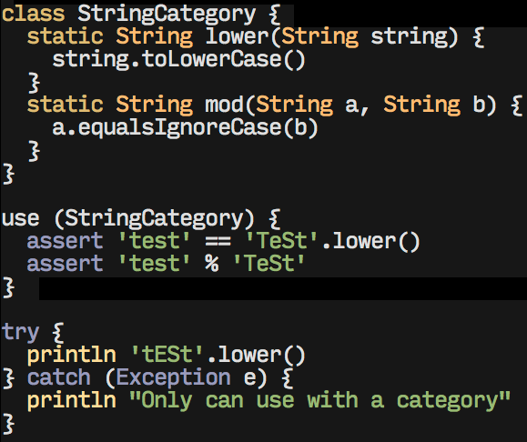
Notes:
Here’s a category definition, adding a couple methods to the String class
You can see we can access those methods within the “use” block, but not outside

Slide 59
REPL
Groovy comes equipped with a command-line shell and a graphical console.
Makes things easier to test on the fly, much like python, node, etc.
Notes:
Demo?

Slide 60
Programmatic Shell
You can create the GroovyShell within your program.
It can parse and run a script from a file, or just a regular string

Slide 61
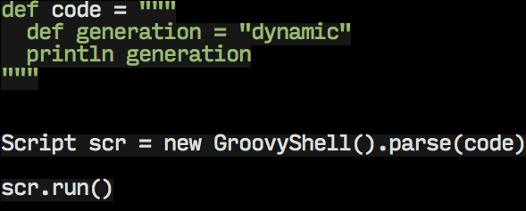
Notes:
So here we’re creating a Script object by parsing some groovy source code
We can then run that Script anytime we like.
This is pretty contrived, but a more common use would be for live reloading of a class (Demo)

Slide 62
DSL
We can combine metaprogramming with dynamic code execution to create a custom DSL
Requires a few acrobatics
Notes:
Demo

